Slide 1
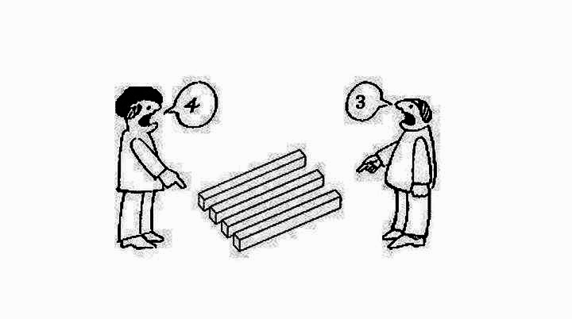
Chapter 3: Perceiving the Self and Others

Slide 2

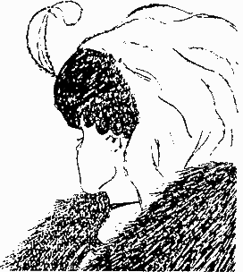
What is Perception?
A cognitive process through which we interpret our experiences and form our own unique understandings
I.e., A may think C is an airhead but B may think C is intelligent
What affects and formulate our perceptions?
Cognitions
It influences how and what we communicate to others

Slide 3
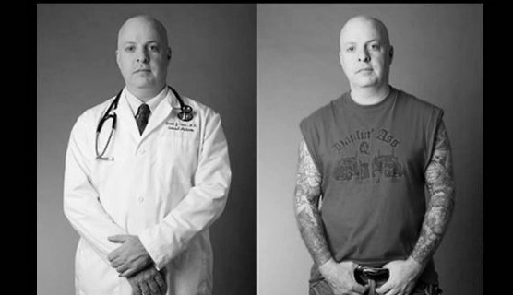

First Impressions
What you think vs. How it really is
The first impression exercise on the first day
Your first impression may alter the way you view the person, as well as communicate with that person

Slide 4
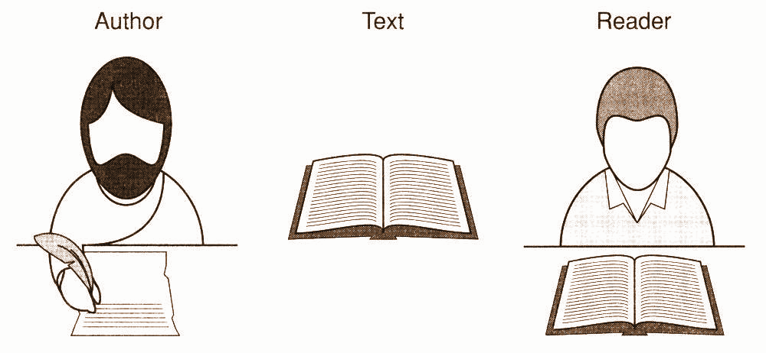
Communication Processing
Gather
Organize
Evaluate
All information that you receive

Slide 5
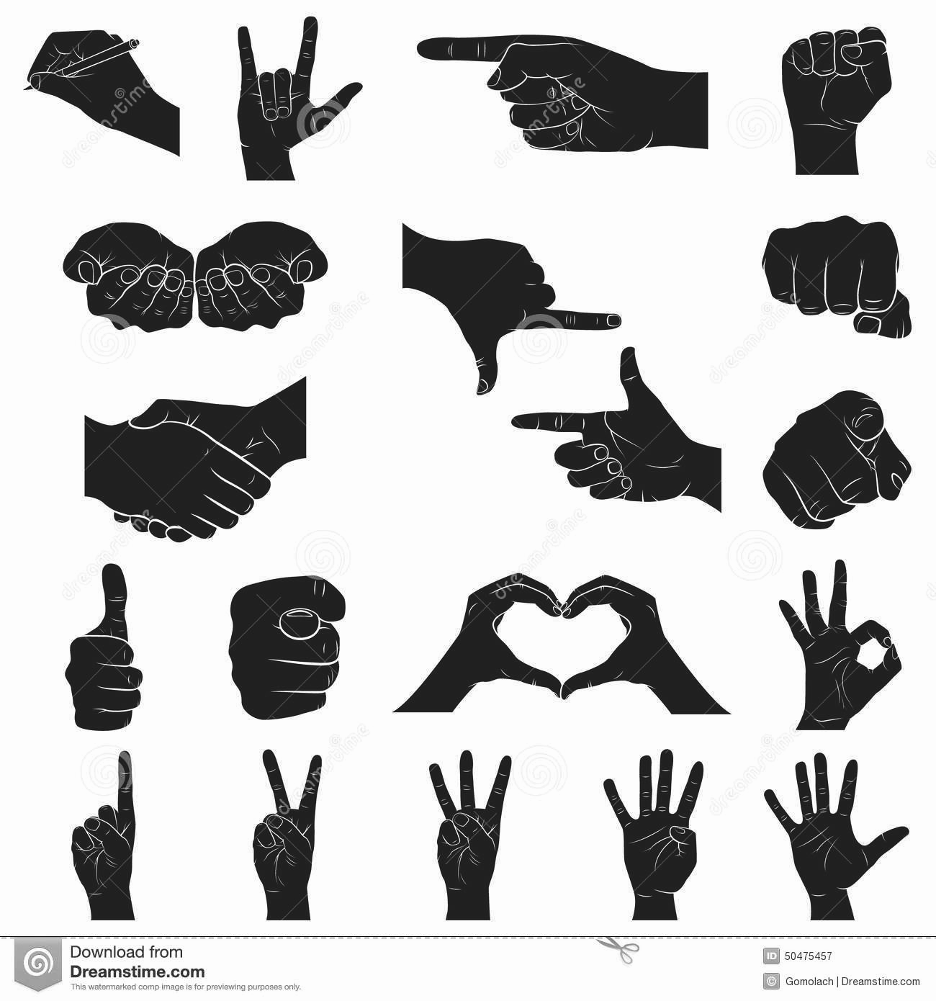
Perception Process
Selecting Information
Organizing Information
Interpreting Information
Improving Information

Slide 6

Schemas
Mental structures that put together related bits of information
Help us understand how things work or should work
Evolve and change over time (interaction appearance theory)

Slide 7
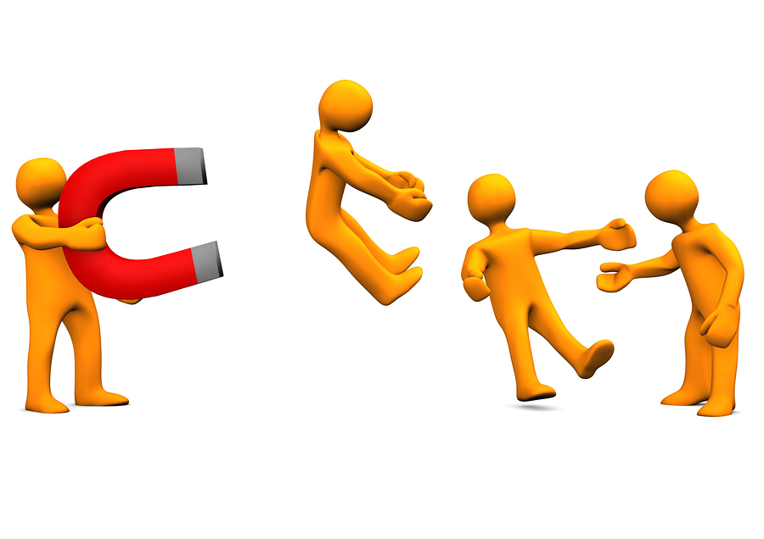
Interaction Appearance Theory
Helps explain how people change their perceptions of someone the more they interact
I.e., the more you get to know someone may change the levels of attraction towards that person (more or less)

Slide 8
Challenges with Schemas & Perception
Mindlessness vs. Mindfulness
Selective Perception vs. Distorted Perception
Undue Influence

Slide 9
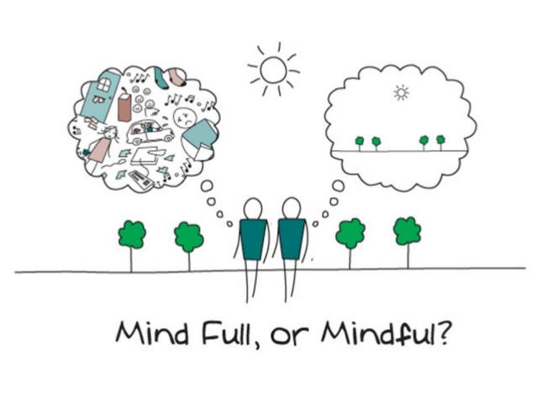
Mindlessness vs. Mindfulness
Mindlessness → less critical processor of information
Pro: it can help you handle some transactions automatically (i.e., you don’t have to think about HOW to place an order at a restaurant)
Con: careless, cannot recall simple things/smaller details, uncritical evaluations
Known as processing information passively
Mindfulness → aware of yourself and tuning out distractions to focus
Complete opposite of mindlessness

Slide 10
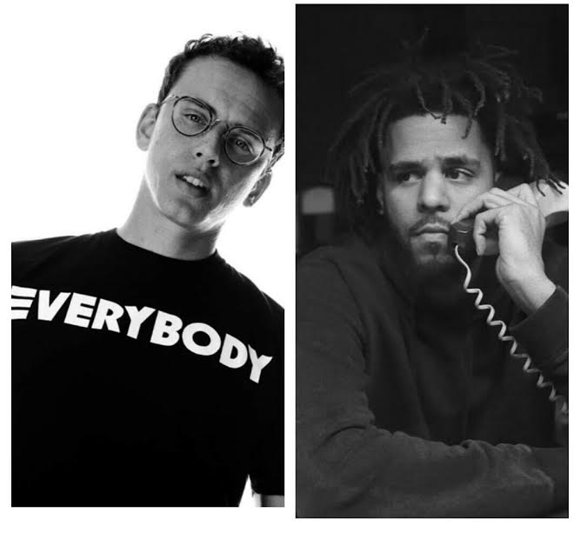
Selective Perception vs. Distorted Perception
Selective Perceptions refers to biased perceptions
We pay attention to information that is consistent to our schemas
In other words, receiving only the information WE WANT
I.e., when two people telling the same story but one person has a little more details than the other, you will trust the one with more details
Distorted Perception
Judging events based on vivid information
I.e., you and your friend are watching two performance from VMAs (J.Cole vs. Logic) but since you are a bigger fan of J.Cole you will automatically think J.Cole did a better job than Logic

Slide 11
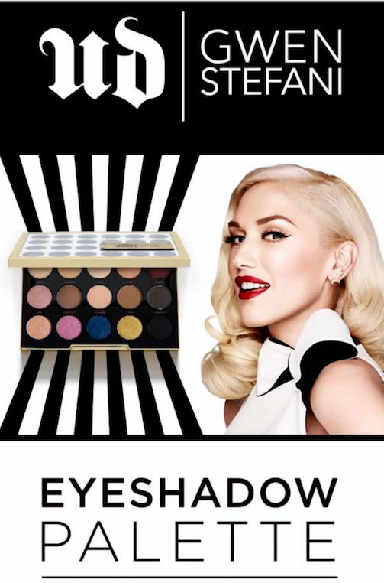
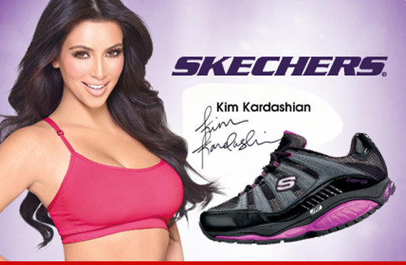
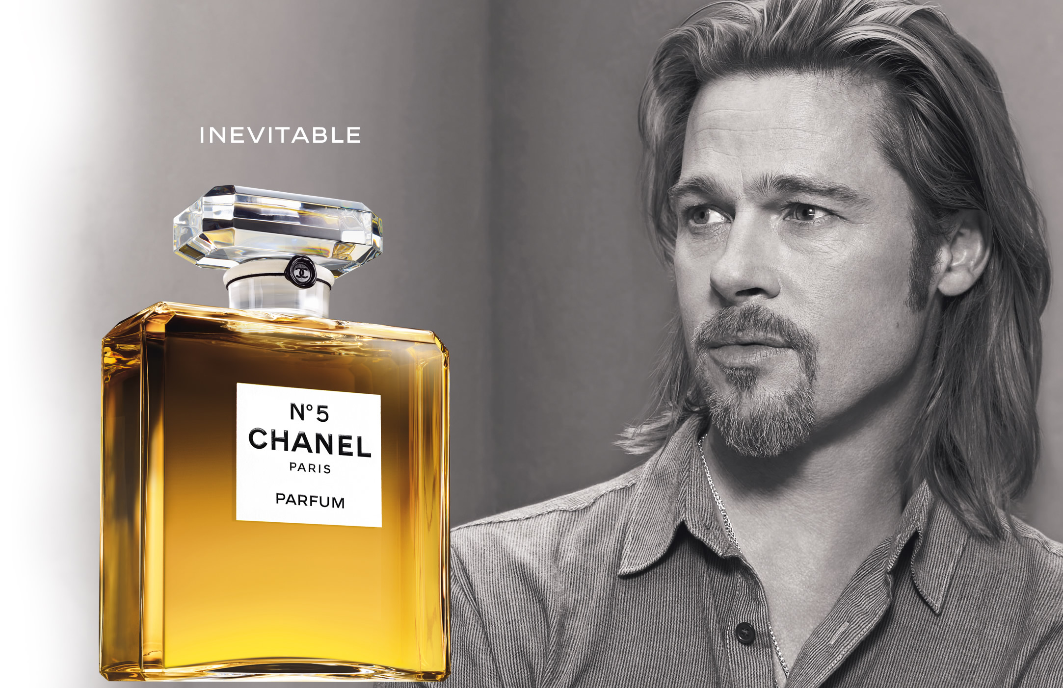
Undue Influence
Giving another person power over your perceptions
For instance, companies love to use celebrities to endorse their products to increase sales even IF that celebrity is not an expert regarding that specific product

Slide 12

Attributions: Interpreting your Perceptions
Attributions: personal characteristics used to explain others’ behaviors
Fundamental attribution error: overemphasizing internal causes and underestimating external causes of behaviors (Noah failed the midterm because he’s lazy vs. he failed because he works 2 jobs + full time student with minimal time to study)
Self-serving bias: attributing personal success to internal factors (i.e., I got an A because I’m smart vs. I failed because my professor sucks)

Slide 13
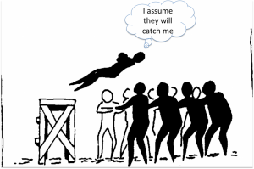
Improving your Perceptions
Be thoughtful when you seek explanations (i.e., your bf/gf always text you good morning at 6 a.m. why?)
Look beyond first impressions (i.e., first impressions are not everything, it may lead to inaccurate conclusions)
Question your assumptions; don’t assume (i.e., all sorority and fraternity members are party people)

Slide 14

Perceptions in a Diverse World
Culture affects how we perceive ourselves and others.

Slide 15
Perceptual Barriers
Narrow perspective
Cultural myopia: believing one’s own culture is appropriate and relevant in all situations
This is especially dangerous because members from a dominant group in a society are unaware and insensitive towards other members in the same society
Stereotyping
The act of assuming that individuals -- because they belong to certain groups they have a set of attitudes, behaviors, skills, morals, or habits
May be positive, negative, or neutral
I.e., the first day I said I’m an Asian but I can drive (lol); earlier slides regarding sorority and fraternity
Prejudice
A deep-seated feeling of unkindness and ill will toward particular groups (often accompanied by feelings of superiority over those groups

